Slide 1
Vacation Rules Amendment

Slide 2
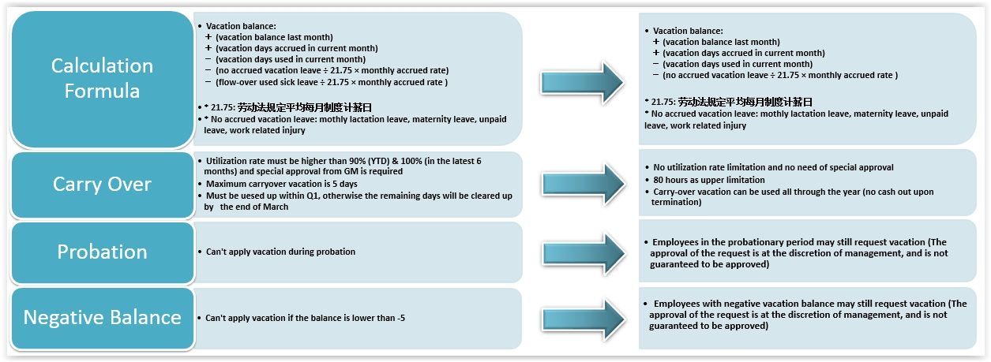
Vacation Policy Amendment
Notes:
平均每月制度计薪日，具体计算方法为：
年记薪总天数：365天－104天（为一年52周的双休日）=261天
平均月记薪日：261天÷12月=21.75天/月

Slide 3
Vacation Policy Amendment
年休假的一般规则 Vacation general rules
所有带薪年假必须安排在员工、客户及本公司均适合的时段。员工应尽量在非billable的工作时间段内安排休假。
All annual paid leave must be arranged at a time that is mutually convenient for employees, our
clients and Perficient. Ideally, employees should try to schedule their paid leave during periods
when they are not billable.
一旦员工提出辞职，不得再享有带薪年假。除非员工和公司有特殊的协议。
Once an Employee has tendered his/her resignation, the leave cannot be taken in lieu of notice
period. All leave applied during the notice period will be cancelled unless there is special
agreement between the employee and the Company.
带薪年假的离职结算 Annual Paid Leave payment upon termination
任何未享受的剩余的带薪年假在员工离职时根据其离职当月的基本工资进行支付（支付上限为10天）。
Any accrued but unused annual paid leave through employee service period will be paid to
employee based on the base salary upon termination of employment（10 days as upper limitation).
任何提前享受但未挣得的带薪年假在员工离职时根据其离职当月的基本工资以薪酬方式补偿给公司。
Any used but unearned annual paid leave through employee service period should be paid back
to the company based on the base salary upon termination of employment.

Slide 4
Thank You !

